Slide 1
Meeting with the AAUP Executive Committee
Kaplan Conference Room
Tuesday, August 11, 2015

Slide 2
The “New Normal”
In today’s global, technologically-driven economy, a college degree is more important than ever.
While this is a major opportunity for higher education, there are a number of challenges that we face in this new and exciting environment.
These challenges include:
Decreasing number of high school graduates in New Jersey, the Northeast, and in the many other regional markets we recruit in.
Greater price sensitivity.
Increasing debt levels, both for students and their universities.
Increased fixed costs.
Increasing government regulations but with decreasing government financial support.
Increasing competition (hyper competition).
Increasing percentage of students who are not academically prepared for college.
Increased focus on the college experience, different delivery methods, student outcomes (immediate vs long-term) and ROI.
Greater emphasis on career-focused, applied, experiential and technology-infused education with greater connection to industry and professional communities … across all disciplines.
Greater competition for philanthropic support.
Less than stable projections for the industry, especially for institutions in our category, by Moody’s and S& P.

Slide 3
Full-Time Undergraduate Enrollment
Growth of 551 students (16%) from Fall 2004 to Fall 2009.
Decline of 339 students (-8%) from Fall 2009 to Fall 2015.
*Fall 2015 enrollment is estimated.

Slide 4
Fall 2015 Projection at August 2015
 | Original Budgeted Goal 2015 | Revised Budgeted Goal June, 2015 | Expected Oct. 1 2015 | # and % to Original Goal
Freshman | 1010 | 935 | 883 | -127 (87%)
Transfer | 235 | 235 | 235 | (100%)
Returning Students | 2564 | 2485 | 2511 | -53 (98%)
CCS & International | 80 | 80 | 82 | +2 (102%)
Total | 3889 | 3735 | 3711 | -178 (95%)

Slide 5
Graduate, CCS and PT Undergrad Enrollment Credits
 | Fall 2004 | Fall 2006 | Fall 2008 | Fall 2010 | Fall 2012 | Fall 2013 | Fall 2014 | Fall 2015*
Undergrad | 3,966 | 4,556 | 4,649 | 4,357 | 3,431 | 3,267 | 2,987 | 2,775
Grad | 7,057 | 7,239 | 7,248 | 7,087 | 6,503 | 6,720 | 6,894 | 6,925
Total | 11,023 | 11,795 | 11,897 | 11,444 | 9,934 | 9,987 | 9,881 | 9,700

Slide 6
Sources of Cumulative Projected Enrollment Growth
Undergraduate Full-time | FY17 | FY18
Current Programs | 20 | 75
Health Science | 13 | 31
Organizational Behavior | 10 | 28
Healthcare Policy & Administration |  | 10
Sport Communication |  | 30
Subtotal New Programs | 23 | 99
Total Growth- Headcount | 43 | 174
Undergraduate PT Credits | FY17 | FY18
Allied Health Studies | 48 | 120
Graduate PT Credits
M.A. Homeland Security | 180 | 506
M.A. Creative Arts Therapy |  | 90
M.A. Public Administration |  | 90
M.A. Business Comm./Health |  | 45
Total Growth- Credits | $ 228 | $ 851
Combined Net Revenue* | $ 961,000 | $ 3,665,000
After all instructional and operating costs, includes housing/dining net revenue Subject to governance and external program approvals

Slide 7
Competitor Profiles and Advantages
 | Academic Year 2014-15 | Academic Year 2012-13* |  |  |  | Academic Year 2014-15
Institution | Rider Admits Attending Competitor | Cost of Attendance $ | Avg. Net Price $ | 6-yr Graduation Rate (Fall 2007 cohort) | Grad Rate Rank | US News Ranking | US News Category
Rider University |  | 48,170 | 28,980 | 65.8% | 6 | 23 | Regional
Rowan University | 343 | 23,570 | 19,164 | 69.8% | 4 | 19 (tie) | Regional
Rutgers University-New Brunswick | 301 | 25,077 | 16,040 | 79.4% | 1 | 79 | National
Montclair State University | 271 | 25,228 | 13,265 | 63.4% | 9 | 50 (tie) | Regional
Monmouth University | 203 | 42,562 | 28,884 | 60.8% | 10 | 37 | Regional
Richard Stockton College of New Jersey | 139 | 23,274 | 15,582 | 65.5% | 7 | 41 (tie) | Regional
Ramapo College of New Jersey | 111 | 24,937 | 16,005 | 72.8% | 3 | 28 (tie) | Regional
Fairleigh Dickinson University-Florham** | 103 | 49,537 | 25,929 | 54.0% | 11 | 79 (tie) | Regional
Rutgers University-Newark | 100 | 25,377 | 10,601 | 67.5% | 5 | 126 (tie) | National
Seton Hall University | 92 | 48,934 | 26,312 | 64.1% | 8 | 126 | National
Saint Joseph's University | 71 | 52,122 | 34,347 | 78.5% | 2 | 11 (tie) | Regional
The College of New Jersey** | N/A | 27,237 | 18,464 | 84.4% |  | 3 (tie) | Regional
* Most recent available data per the current Department of Education College Scorecard website except Cost of Attendance which is per prior Rider data collection from competitor websites.
*TCNJ blocks individual student records from being reported by the Clearinghouse. While we cannot provide a rank or number of admits attending, we know from other data collection methods that TCNJ remains a top competitor.

Slide 8
Cumulative Growth in FTUG Enrollment by Sector Fall 1998 to 2014
Public Universities have grown by 12,000 students since 2009
Private universities are exclusive of Princeton University
Source: NJ Department of Higher Education

Slide 9
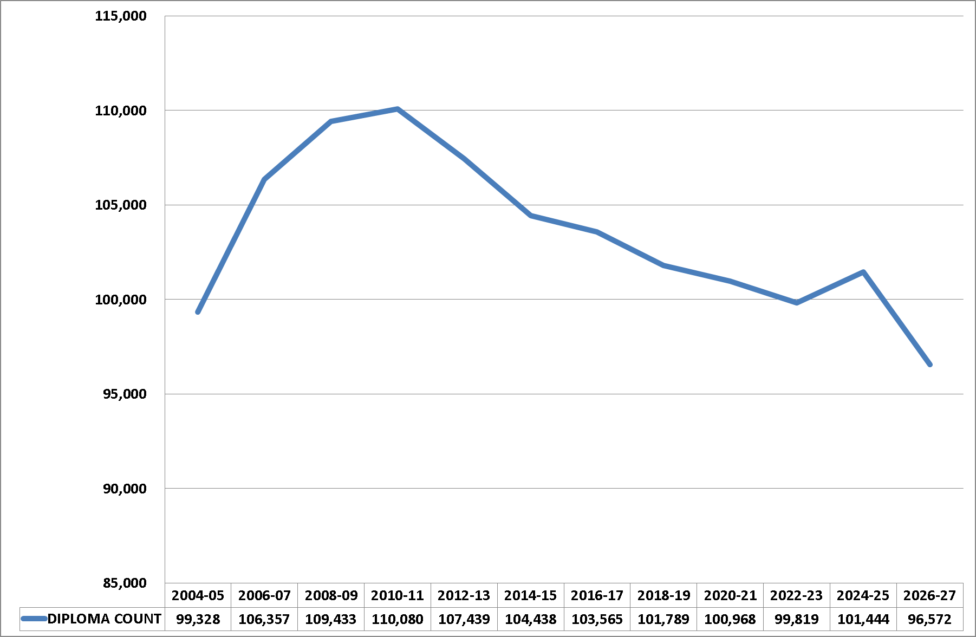
Actual and Projected NJ High School Grads
Spring 2015 Graduates
Spring 2015
Spring 2023
Source: Western Interstate Commission for Higher Education (http://knocking.wiche.edu/explore?state_id=NJ)

Slide 10
Rider’s Rising Discount Rate

Slide 11
Limit Tuition Revenue Growth for Freshman and Overall per FTE Revenue
Sources: Overall per University audited financials and FTE enrollment, Freshman per Enrollment Mgmt.

Slide 12
Enrollment Declines Also Impact Housing Occupancy
100% housing occupancy is 2,475 Fall 2015 is estimated
Source: Student Affairs

Slide 13
All Contribute to Dwindling Net Revenue, Limit Program/Facility Investment
Successive budget cuts have been required to maintain balance
Source: Audited financial statements

Slide 14
Declining Resources Expendable Net Assets (000s omitted)
Source: Audited financial statements, adjusted to exclude plant net assets

Slide 15
Flat Revenues and Rising Costs Expand the Operating Budget Gap (000’s omitted)
 |  |  | Fiscal 2015 | Fiscal 2016 | Variance
 |  |  | as of | as of
 |  |  | June 2015 | June 2015
REVENUES:
TUITION AND FEES |  |  | 165,112 | 169,299 | 4,187
SCHOLARSHIPS |  |  | (56,371) | (59,252) | (2,881)
NET TUITION AND FEES |  |  | 108,741 | 110,047 | 1,306
GIFTS AND GRANTS |  |  | 1,599 | 1,799 | 200
ENDOWMENT AND INVESTMENT INCOME |  |  | 735 | 436 | (299)
ROOM AND BOARD |  |  | 31,164 | 29,851 | (1,313)
OTHER |  |  | 9,193 | 9,229 | 36
TOTAL REVENUES |  |  | 151,432 | 151,362 | (70)
EXPENDITURES AND TRANSFERS:
SALARIES & STUDENT WAGES |  |  | 74,136 | 76,168 | 2,032
FRINGE BENEFITS |  |  | 22,639 | 24,238 | 1,599
CONTINGENCY |  |  | 300 | 2,000 | 1,700
OTHER OPERATING |  |  | 55,393 | 55,623 | 230
TOTAL EXPENDITURES |  |  | 152,468 | 158,029 | 5,561
NET REVENUE (DEFICIT) |  |  | (1,036) | (6,667) | (5,631)

Slide 16
Three Year Operating Forecast at June 2016
 |  | Fiscal 2016 |  | Fiscal 2017 | Fiscal 2018 |  | Total |  | Note
Net Deficit at June |  | (6,667) |  | (6,088) | (7,654) |  | (20,409)
Deficit Reduction Initiatives:
New program revenue, net |  | - |  | 961 | 3,665 |  | 4,626 |  | 1
Target reductions |  | 500 |  | 500 | 500 |  | 1,500 |  | 2
Executive compensation adjustment |  | 200 |  | - | - |  | 200
Restricted funds to cover key expense |  | 251 |  | - | - |  | 251 |  | 3
Subtotal |  | (5,716) |  | (4,627) | (3,489) |  | (13,832)
1. New program revenue, plus housing/dining revenue, less program and dining plan costs
2. Additional fiscal 2016 base budget cuts produce savings in subsequent years. (Not incremental cuts.)
3. One time use of donor funds to underwrite costs. Fully compliant with donor restrictions.
Quasi-endowment at June 2015 totaled $10.2 million, with $8.0 million authorized for deficit spending.

Slide 17
Conclusions
Enrollment declines have limited Rider’s ability to make key strategic investments it needs to make in this changing environment (i.e., the New Normal) and which many of our competitors are already making
More discounting is not financially possible- expenditures must be further reduced until a more competitive strategic plan can be implemented and enrollments rebound (as well as other non-tuition revenue sources)
Rider is spending quasi-endowment on operating costs and faces persistent budget gaps even with new program goals
Borrowing for operating needs is challenging
Other employee groups have experienced multiple year wage freezes, staff reductions, and benefits cuts (pension and other)
We are asking the AAUP membership to also help contribute to the solution

